Slide 1
Real E-MUST
‘Electrical Muscle Stimulation and Training’
THE innovative concept
for electrical muscle stimulation
using an ideal form, duration,
frequency and intensity
of the applied electrical impulse
Lievens, EOS, 2003, April, 55-59

Slide 2
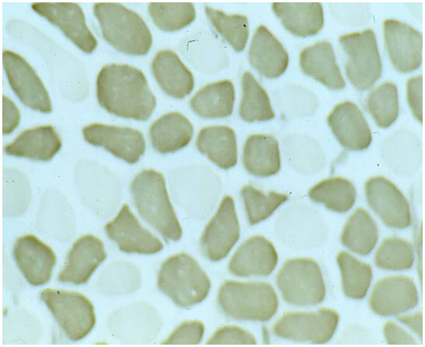
Real E-MUST
THE innovative technique
to
. stimulate weak muscles
. strengthen healthy muscles
with positive effects on the
general well-being
Tassenoy en Lievens, Kine, 2000, 13, 96-102

Slide 3
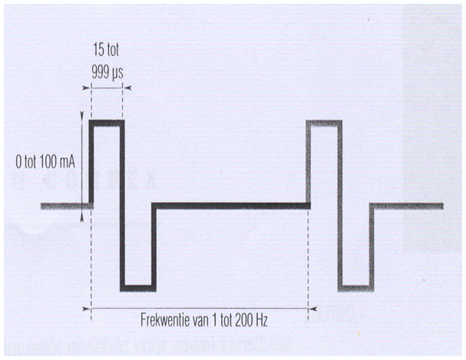
Real E-MUST
Existing devices
use ultrashort pulses
(microseconds)
which only elicit
a local muscle contraction
….. and with
a negligible activation
of the muscle fibers
µs
Lievens, World Congress Physical Therapy, 1999, Japan

Slide 4
Real E-MUST
These devices stimulate muscles
by increasing the intensity of the pulse,
which is associated with the production of heat
( Q = I² x t x R)
DISADVANTAGES:
- skin irritation
- thermal injury
- increased pain
- intolerance

Slide 5
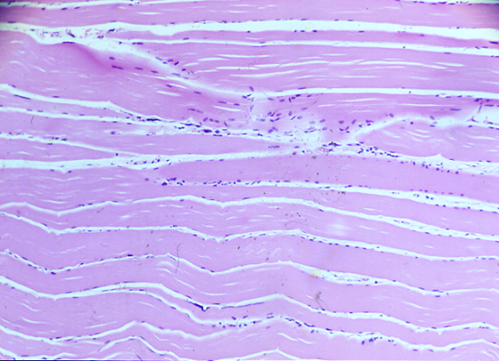
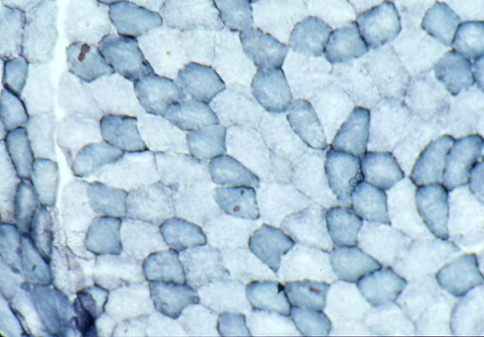
Real E-MUST
The total strength of a
muscle depends on
the number of its
active muscle fibers
Different fibers
. type - I (dark)
. type – II (lighter)
Kakulas, Perth, Australia

Slide 6
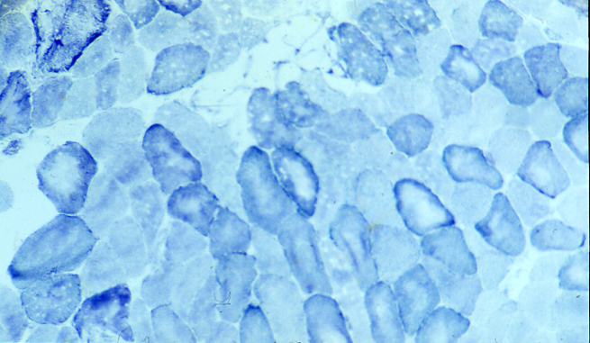
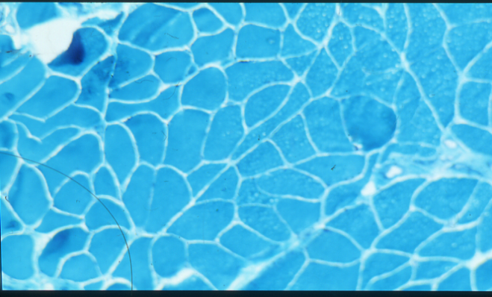
Real E-MUST
Inactivity:
muscle fibers are
developed to a lesser
extend
Activity:
development to a larger
extend
Kakulas, Perth, Australia

Slide 7
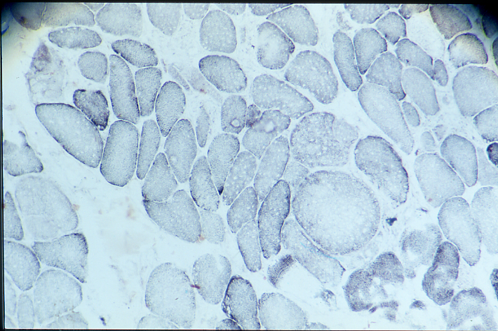
Real E-MUST
…
A large number of muscle fibers
remain unused
even following the most
intensive training

Slide 8
Real E-MUST
The E-MUST stimulates all muscle fibers,
the active as well as the unused ones:
. without skin irritation or thermal injury
. without pain but with a pleasant sensation
. giving a full muscle contraction
. giving the feeling of training the muscle

Slide 9
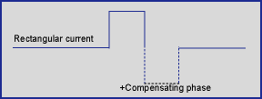
Real E-MUST
For muscle stimulation, the Real E-MUST
uses a rectangular current with a
compensating phase
Lievens, Congress Chartered Society Physiotherapy, 1999, Birmingham

Slide 10
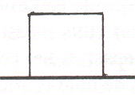
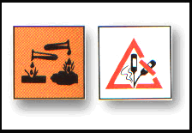
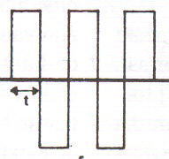
Real E-MUST
monophasic pulse
NO formation
of caustic soda
(NaOH) which
causes burns
biphasic pulse

Slide 11
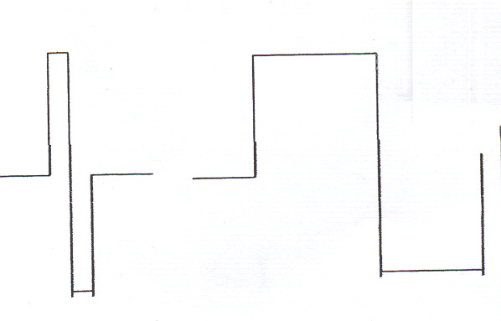
Real E-MUST
The Real E-MUST produces
a 1000 times longer current
(10 milliseconds) and
with 50 pulses / minute
… with experimental proof of
maximal generation of strength
in animals as well as in humans
µs
10 ms
Lievens, Second International and Third National Congress
Physical Education and Sports Science, 2000, Teheran

Slide 12
Real E-MUST
The Real E-MUST uses heated electrodes
Result:
. decrease of the motor threshold during
muscle stimulation
Advantages:
. decrease of the required intensity of the pulse
. suppressing the side-effects

Slide 13
Real E-MUST
Indications for generation maximal strength in a muscle
by Real E-MUST muscle stimulation:
. active sports
. figure styling
. seniors / geriatrics
. rehabilitation following trauma and surgery
. rehabilitation following immobilisation and rest
. low back pain: strengthening of spinal muscles
. childbirth: strengthening of the abdominals
. symptoms of paresis and paralysis
. conditions with (painful) stiffness
. multiple sclerosis (MS)
. …

Slide 14
Real E-MUST
The Real E-MUST in active sports
Exceptionally efficient to further increase the level of muscle performance, on top of your daily trainingsessions
→ +/- 16 % increase of strength of the quadriceps
in a professional cyclist in ONE month

Slide 15
Real E-MUST
The Real E-MUST
following replacement of hip / knee
. 15 patients
. 5 days / week for one month
. 15 minutes stimulation of the quadriceps per day
→ spectacular shortening of recovery:
. gain in muscle strength: +/- 12 %
. increase of muscle volume: +/- 1 cm

Slide 16
Real E-MUST
The Real E-MUST
in paraparetic / paralytic conditions
. Guillain-Barré (segmental demyelinisation)
. daily stimulation for one month
→ spectacular results in comparison with other modalities of stimulation
. Tetraplegia
. 4 times per week for one month
→ . 5% gain in muscle volume
. NO skin irritation
(compared to traditional stimulation modalities)

Slide 17
Real E-MUST
No contraindications
when the Real E-MUST
is administered
and safely applicated
following the instructions

Slide 18
Real E-MUST
The Real E-MUST
. very easy administration
. not invasive
. not addictive
. allows independent application
. provides TENS as well (pulseduration of 1 msec) as a treatment for chronic and acute pain

Slide 19
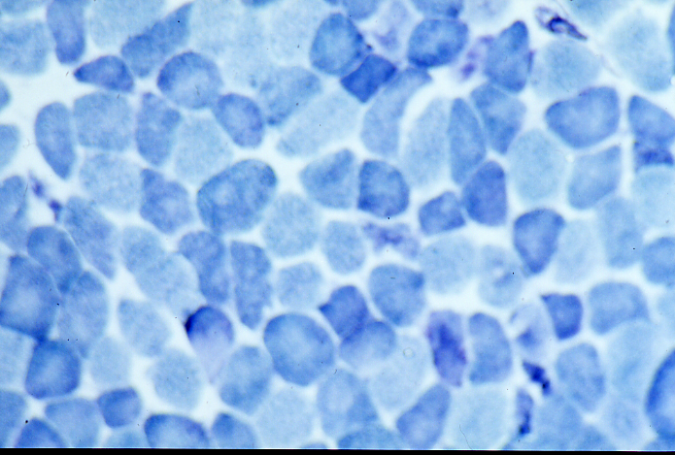
Real E-MUST
The FIRST and UNIQUE device
for electrical stimulation
of muscles
guaranteeing
maximal muscle strength
without any danger
and without any discomfort
for the user

